Slide 1

Transfer Reform
(AB 928, AB 1111)
SPR ‘24 Transfer Advisory Committee Meeting
Presented by Stacey Howard, NVC Articulation Officer/Counselor
Notes:
NOTE:
To change the image on this slide, select the picture and delete it. Then click the Pictures icon in the placeholder to insert your own image.

Slide 2
Overview of AB 928 (Berman, 2021)
AB928 – Student Transfer Achievement Reform Act of 2021
  Enacted Jan. 1, 2022
State mandated – Implementation Fall 2025
Intersegmental Committee of the Academic Senates (ICAS) of the University of California (UC), California State University (CSU) and California Community Colleges (CCC) must establish a single lower division general education pathway
IGETC + CSU GE Breadth = Cal-GETC (Begins Fall 2025)
  CSU system voted to adopt Cal-GETC across 23 campuses (March 2024)
ADT Placement aka Auto-Enroll (Begins Aug. 1 2024)
  Requires CCCs to place students on Associate Degree for Transfer (ADT) pathways if a such a pathway exists for the students’ stated major and unless student opts out (sample definition of opting out).

Slide 3
Cal-GETC Differences
Cal-GETC is a unified GE transfer pattern that was mapped against IGETC. Key changes include:
  Unit reduction in singular pattern to include 11 courses and 34 units
  Area 1C Oral Comm Cal-GETC applies to both UC and CSU; redeveloped as a new area. Revision and strengthening of Oral Comm to meet new core competencies
  Language Other than English proficiency requirement removed (currently UC only, will remain UC graduation requirement)
  Ethnic Studies carries over from 24-25 IGETC pattern
  Area E Self Development & Lifelong learning CSU GE will not be in Cal-GETC
IGETC to Cal-GETC ASSIST data migration project (Summer 2024)
Cal-GETC to go live to the public on ASSIST.org with searchable lists (Fall 2025)

Slide 4
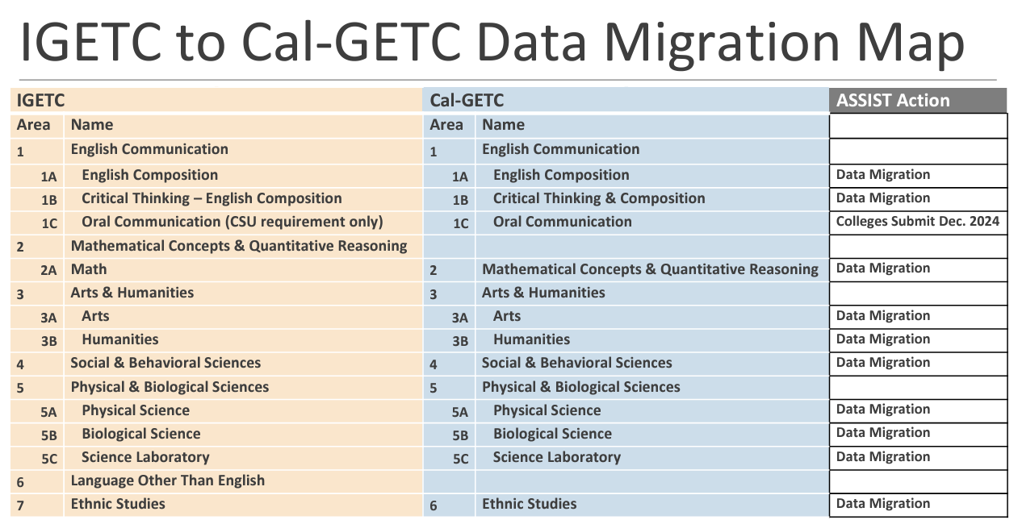
Transfer General Education Patterns and Cal-GETC
The NVC Articulation Office maintains the college’s GE course lists:
CSU General Education Worksheets
IGETC General Education Worksheets
Cal-GETC Sample Certification Form
Cal-GETC implementation plan details are available at:
ccctransfer.org/cal-getc
(CCC Transfer Counselor Web site)

Slide 5
Overview of AB 1111 (Berman, 2021)
AB1111 - Postsecondary Education: Common Course Numbering
  Enacted Oct. 1, 2021
The Common Course Numbering Project requires implementation of a student-facing common course numbering (CCN) system across the California community Colleges.
Focus on streamlining transfer by creating conditions for seamless articulation (system-to system and course-to-course)
Recent guidance
    Chancellor’s Office CCN Memo ESLEI 24-22 Via Email April 15, 2024
    ASCCC.org April 16 update and information on CCN Implementation
Phase 1 courses ready for Fall 2025 enrollment and include the highest enrolled courses in our system:
  College Composition, Argumentative Writing and Critical Thinking, Public, Speaking, Introduction to Statistics, Introduction to American Government and Politics, Introduction to Psychology

Slide 6
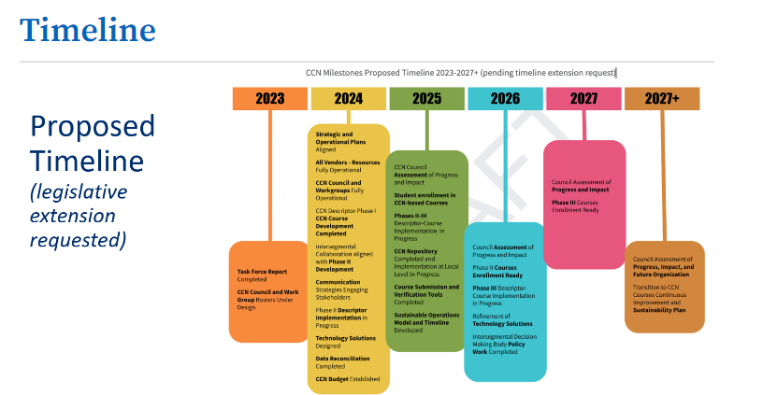
CCN Timeline
Original mandate and expected implementation July 1, 2024. The CO proposed an extended timeline for full implementation
Notes:
.

Slide 7
Resources
CCC Transfer Counselor Web Site (Cal-GETC Implementation) (Feb. 24)
Cal-GETC Standards 1.1 (Jan 24)
  Intersegmental Committee of Academic Senates (ICAS)
ADT Submission Forms (Transfer Model Curriculum or TMCs)
Cal-GETC Administrative Implementation Guidance
  Memo - Cal-GETC Administrative Implementation Guidance (Feb. 14)
  Memo ESS 23-44 ADT Compliance with Assembly Bill 928 and Cal-GETC Curriculum Submission Guidance
ADT Auto Enroll
  Memo ESS 23-41 Guidance for Implementing the New Associate Degree for Transfer Placement Requirement
2023 Common Course Numbering Report

