Slide 1


Starfish
Early Alert
Office Hour Appointment Feature
*In the Chat, input First Name, Last Name, Department, Classification and Email to receive the Starfish Early Alert Training PowerPoint, Training Guide for Office Hours and additional resources.

Slide 2


Meet your Starfish Trainers
Renee Coffin
Sr. Admin. Assistant
To Sr. Dean Howard Willis
Starfish Project Scribe
Lead Configuration
Starfish Function Team
Starfish Trainer
Jessenia Cota
Counseling Services Specialist
Starfish Admin
Lead Configuration
Starfish Function Team
Starfish Trainer

Slide 3
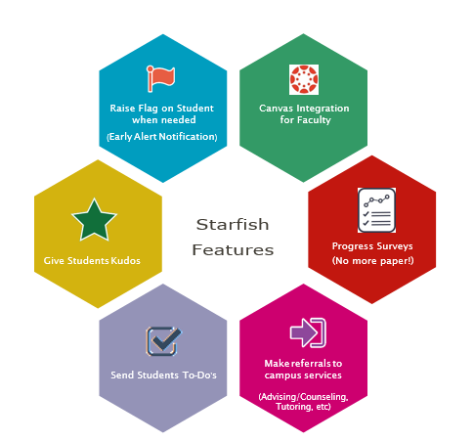
What, Why & Benefits of Starfish Early Alert
What is Starfish?
A retention tool that Napa Valley College will utilize to improve student success, including retention and graduation rates.
A collaborative effort between the campus staff, faculty and administrators (Student Success Networks) to ensure student success and persistence.
*Just some of the features of Phase 1 for NVC - Spring 2021.

Slide 4
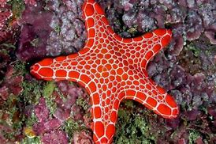
Starfish Training Agenda
Setup your Appointment Preferences
How to Add Office Hours
Check your Set Up
Edit or Cancel Existing Office Hours
Recording Meeting Outcomes
    Outcomes Tab
    SpeedNotes Tab
Student Perspective
Starfish Help & Resources

Slide 5
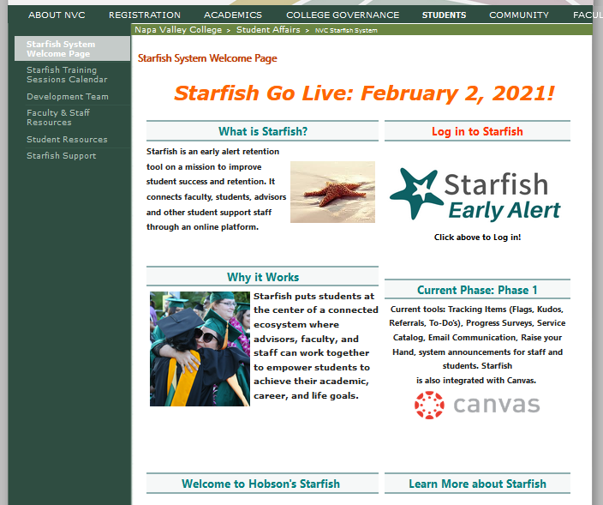
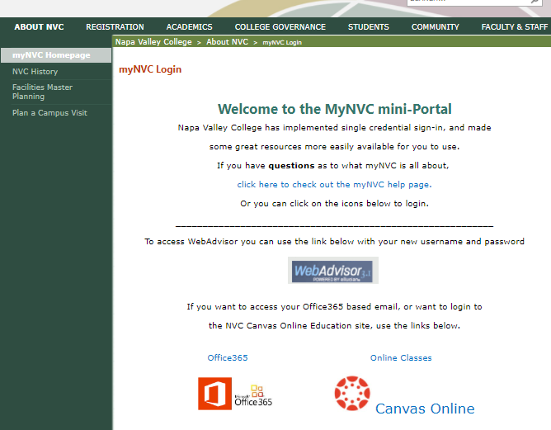
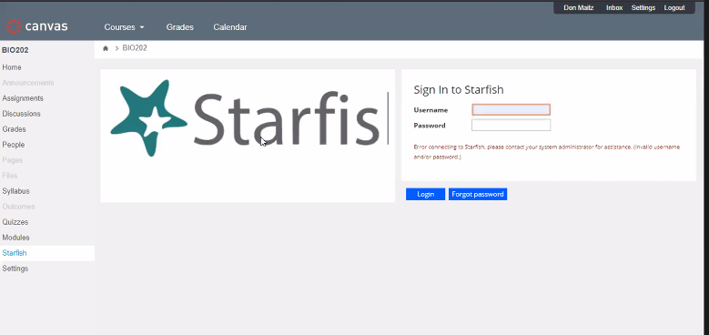
We are LIVE!
Where and How- To Login to Starfish
Single Sign On > NVC Credentials
Starfish Webpage
myNVC Webpage
Canvas Integration
(Instructional Faculty only)
www.napavalley.edu/starfish
www.napavalley.edu/myNVC

Slide 6



Let’s Starfish!
Disclaimer: Student Information will be viewed during Training Session.
Faculty Perspective on Office Hours Feature

Slide 7
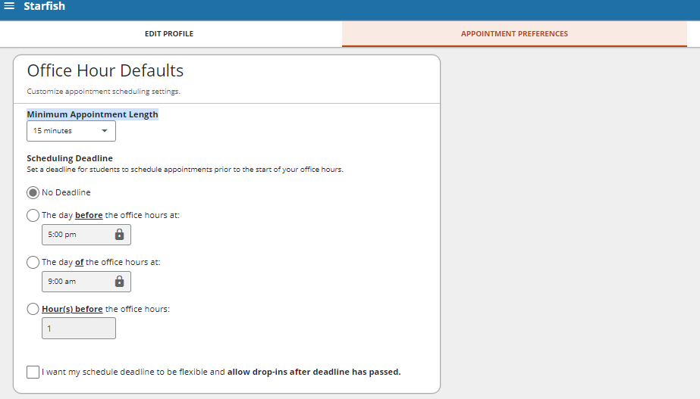
Setting up your Appointment Preferences
Hamburger Menu > Click your name > Appointment Preferences

Slide 8
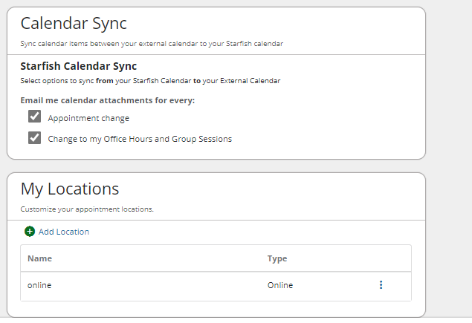
Setting up your Appointment Preferences…
Add your Zoom Links under ‘My Locations’

Slide 9
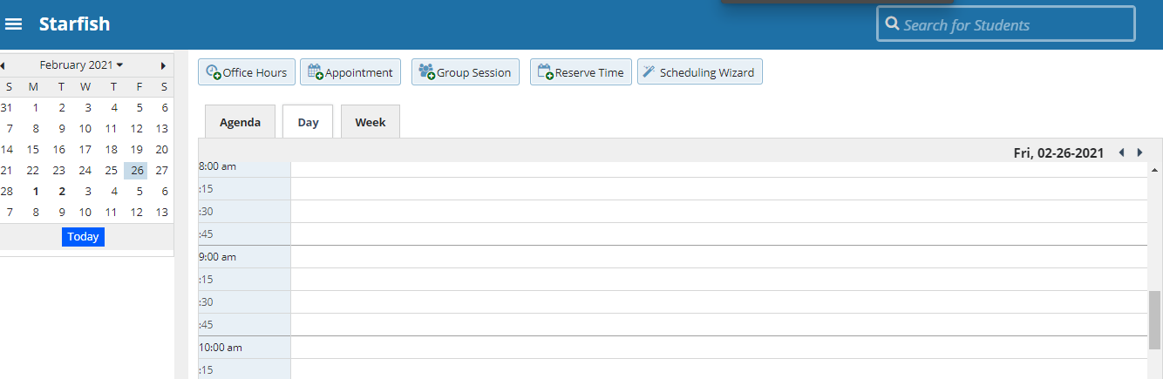
Adding your Office Hours
Hamburger Menu> Appointments > Click on the Add Office Hours Button

Slide 10
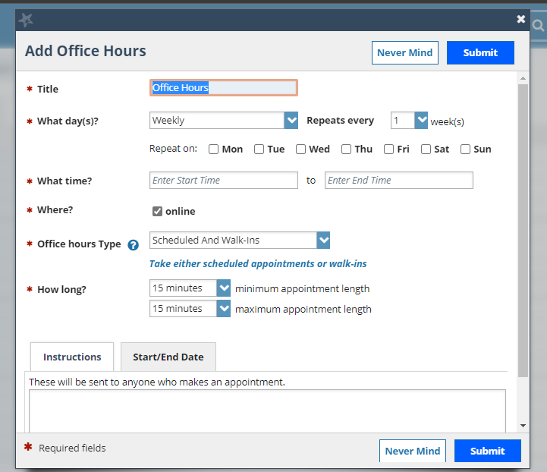
Adding your Office Hours…
Recommend viewing the Getting Started Guide for Office Hours (Starfish Webpage)

Slide 11
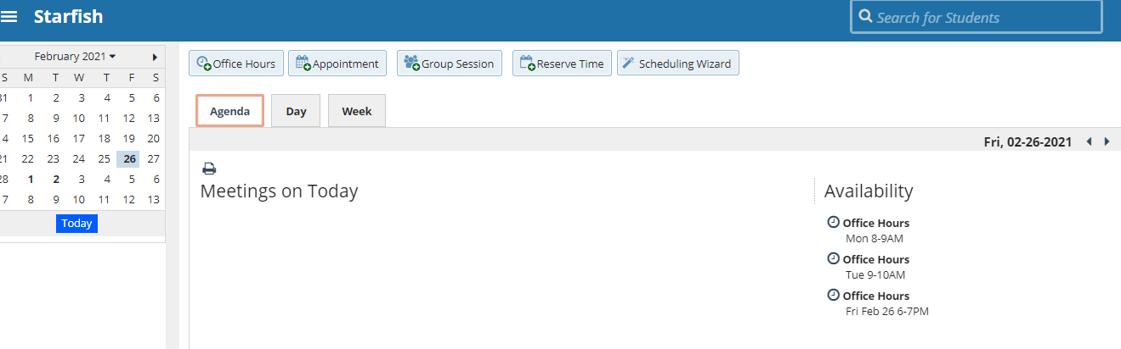
To Check your Setup
Click on View Agenda

Slide 12
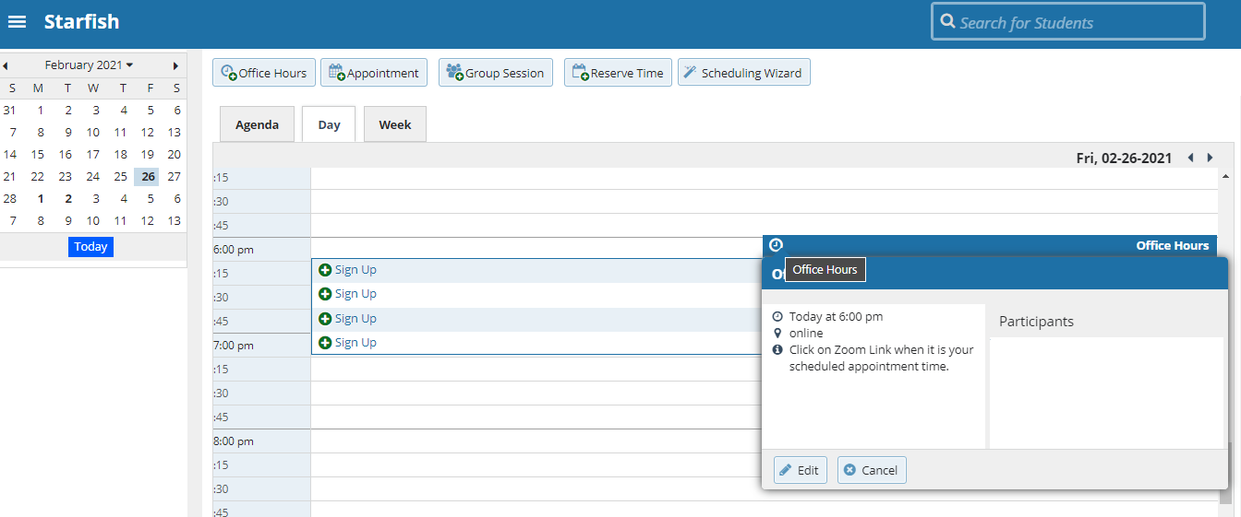
Edit or Cancel (Delete) Existing Office Hours
Hamburger>Appointments>Day> click on Office Hour Icon (clock)

Slide 13
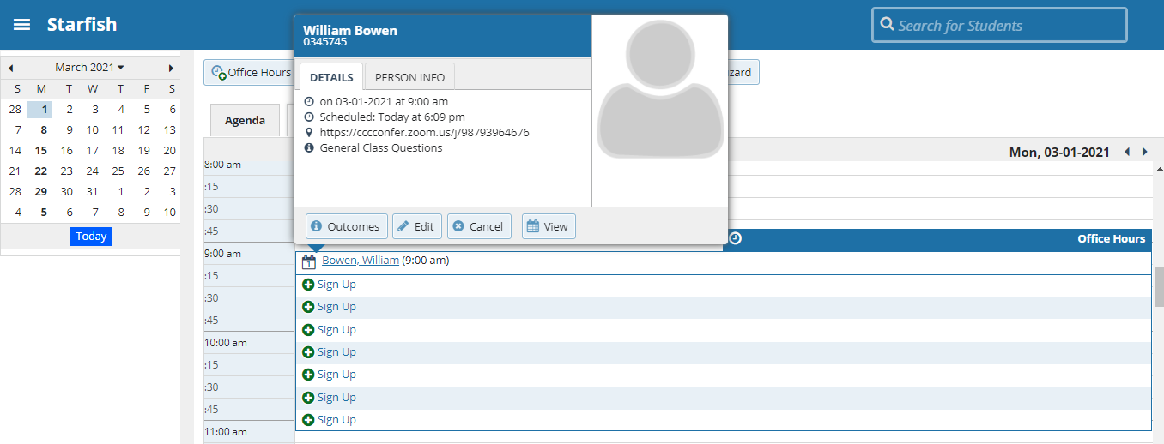
Record Meeting Outcomes in Outcomes Tab
Hover over Appointment Icon associated with the student> Select Outcomes

Slide 14
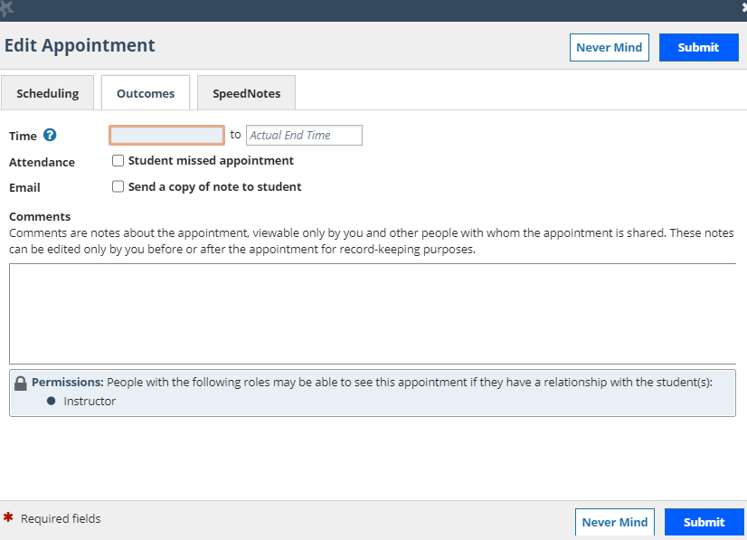
Record Meeting Outcomes in Outcomes Tab…
*Recommend not updating the actual start and end time of Appointment.

Slide 15
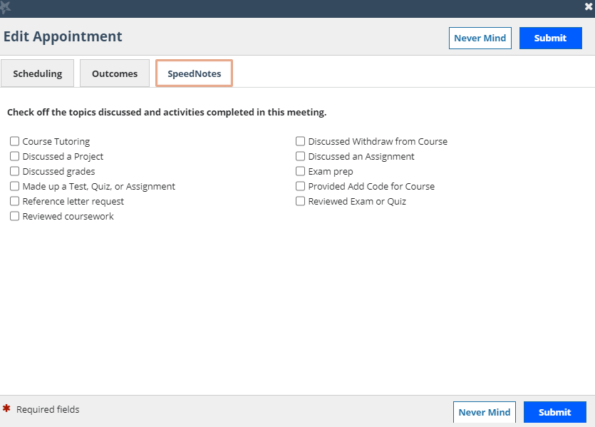
Record Meeting Outcomes in SpeedNotes

Slide 16
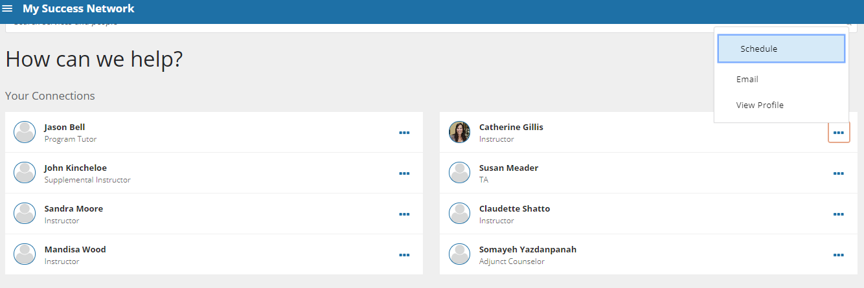
Student Perspective
Hamburger Menu> Success Network> Connections
Can click on “Schedule” or “View Profile” to Schedule Office Hour Appointment

Slide 17
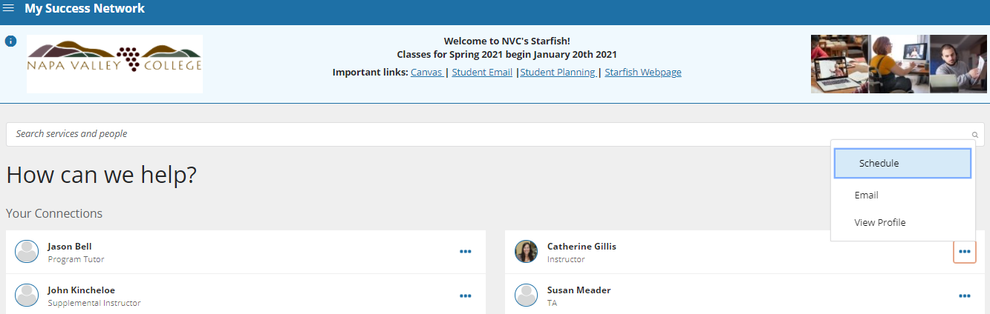
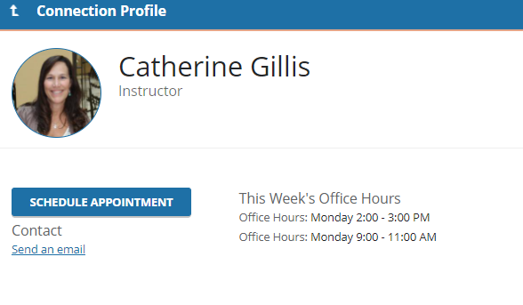
View Instructors Schedule for Office Hours
Hamburger menu> My Success Network > Click … (three dots) for Instructors Profile > Schedule Appointment Button

Slide 18
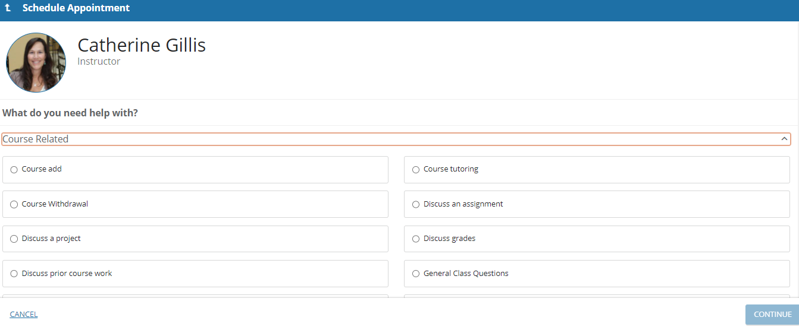
Student Perspective
Click on the down arrow under Course Related > Student Selects Reason for Appointment

Slide 19
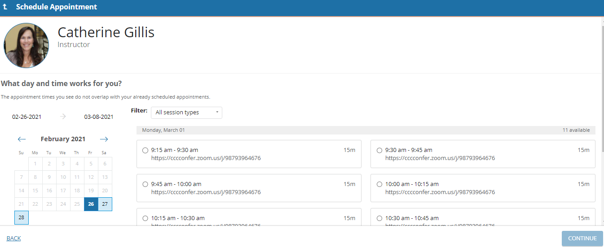
Student Perspective
Student can select the date/time of available office hour appointments

Slide 20
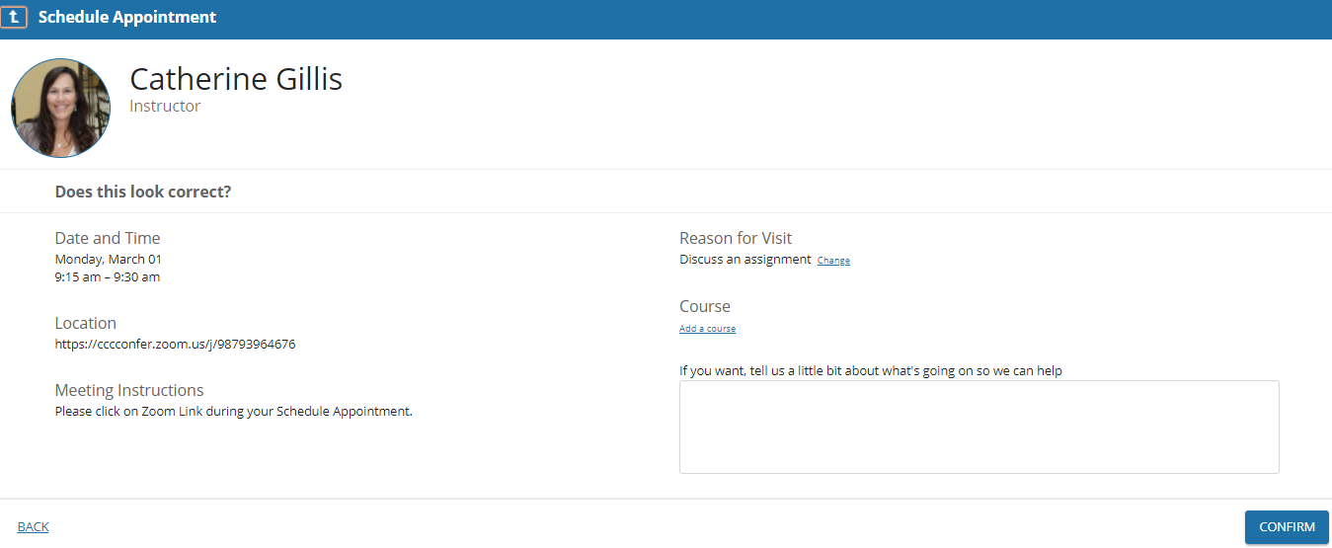
Student Perspective
Students review the date/time selected and can input additional appointment information details in an open field box

Slide 21
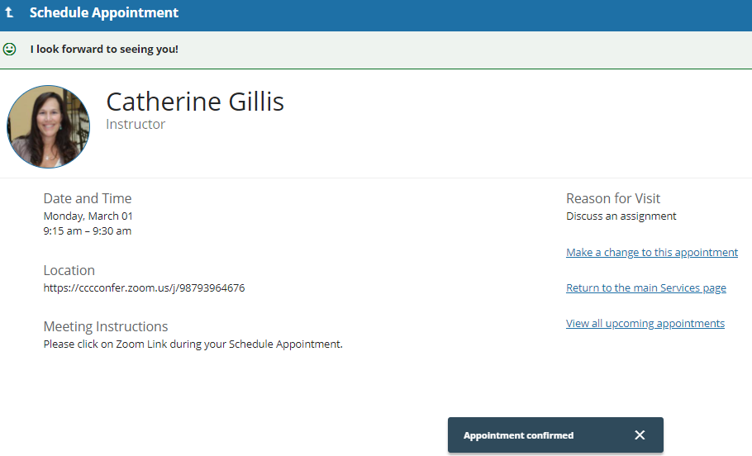
Student Perspective ~ Appointment Confirmation
Student confirms and they receive confirmation on the screen and via an email notification sent to their NVC Email Account. Instructor is also notified via email.

Slide 22
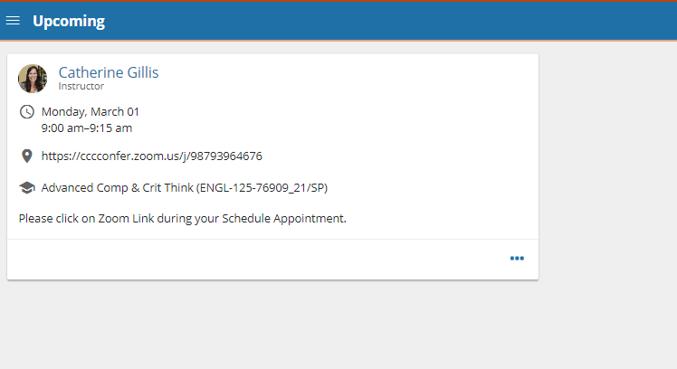
Student Perspective ~ Upcoming Appointments
Hamburger Menu > Upcoming
View Upcoming Appointments

Slide 23
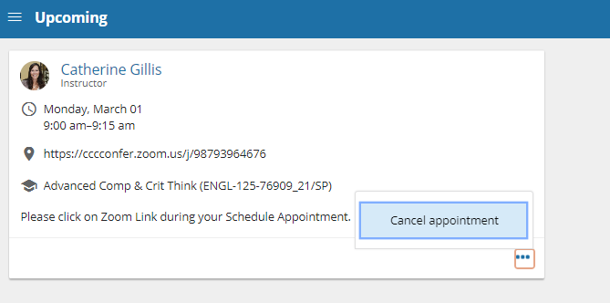
Student Perspective ~ Cancel or Reschedule Apt.
Hamburger Menu > Upcoming > View Corresponding Apt and click on … (three dots)
Note: Instructor and student receives notification when appointment has been cancelled or rescheduled for another time.

Slide 24
Starfish Early Alert Webpage
In-depth Look for Resources & Help
*Visit the Faculty/Staff Resources Tab
www.napavalley.edu/starfish

Slide 25
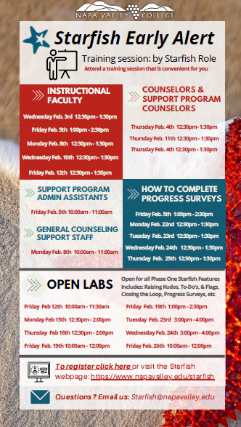

Upcoming Open Labs for March
Starfish ‘Training Session Calendar Tab’ on Webpage:
www.napavalley.edu/starfish

Slide 26

Questions, Inquiries & Answers
Email: Starfish@napavalley.edu
Keep in mind Starfish is new to Napa Valley College and we will be learning to “Starfish” together.

