Slide 1
Training for Faculty Reviewers
2019-2020 AY

Slide 2
Steps in Local Review Process
Step 1: Faculty author proposes/modifies course or program
Step 2: Division Dean reviews for scheduling, feasibility, mission
Step 3: Articulation Officer reviews for GE and transferability (UC/CSU)
Step 4: Curriculum Analyst reviews for completeness (checks codes)
Step 5: Faculty Co-Chair reviews proposal and assigns to content review
Step 6: DE Reviewer check compliance with distance education standards
Step 7: Faculty Librarian reviews for library resources
Step 8: Faculty Reps review for integration, clarity, completeness
Step 9: Curriculum Committee votes on proposal at next meeting
Step 10: Implementation (AS, BOT, CCCCO, Catalog)

Slide 3
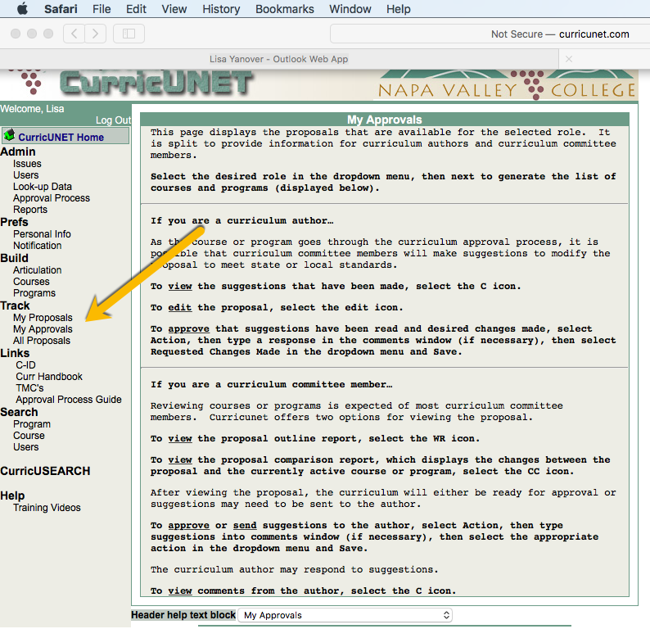
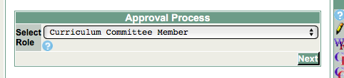
To Review Courses in CurriCUNET
First, select My Approvals.
Next, use the dropdown menu to change your role from Course Author to Curriculum Committee Member.
Then, select a course you have been assigned to review.
  WARNING: Curriculum Committee Members are able to see all courses at this level. Refer to emails from me to know which courses have been assigned to you.

Slide 4
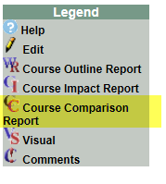
To Review Modified Courses:
Under “Track,” select “My Approvals.”
Then select “Curriculum Committee Member” from the dropdown menu.
To review a modified course proposal, click on the CC (course comparison report icon).
Review the rationale for the changes.
Look particularly at what’s been highlighted to see the changes.
Look also for any missing fields.
Check the Catalog/Schedule Description. Is it clear, written in complete sentences, and does it give a student a clear idea about the course focus and requirements?
Check the textbooks. Was at least one published within the last 5-7 years?
Make sure the course outcomes, objectives, and content align. Also check that the outcomes and objectives are written as verb phrases.

Slide 5
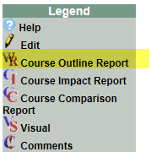
To Review New Courses:
Under “Track,” select “My Approvals.”
Then select “Curriculum Committee Member” from the dropdown menu.
To review a new course proposal, click on the WR (course outline report icon).
Review the outline carefully.
Make sure all fields are complete.
Check the Catalog/Schedule Description. Is it clear, written in complete sentences, and does it give a student a clear idea about the course focus and requirements?
Do the course outcomes, objectives, and content align?
Do all sections that ask for specific examples provide them?
Check the textbooks. Was at least one published within the last 5-7 years?

Slide 6
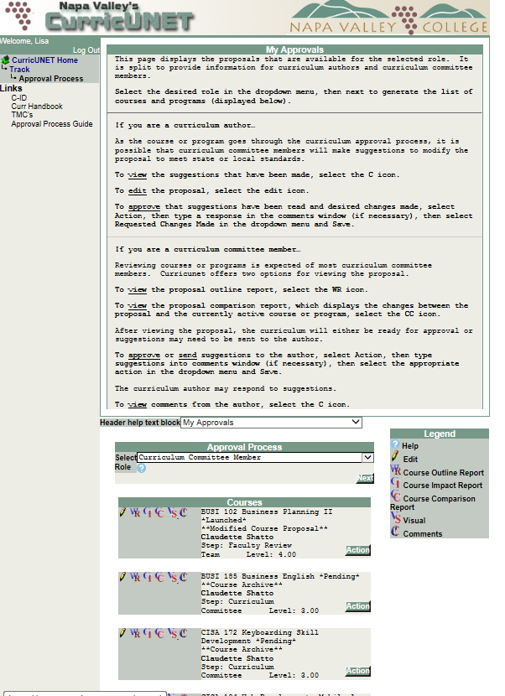
Take Action:
Click on the Action box at the bottom right of the box with the proposal you’re reviewing.

Slide 7
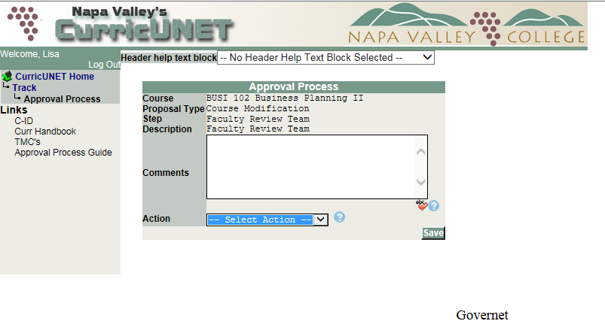
How to move the Proposal forward:
As a faculty reviewer, you have 2 options to move the proposal on to the next step:
Approve the proposal as is by selecting “Reviewed”.
Return the proposal to the faculty author (originator) for changes by selecting “Changes requested.”
      If you request changes, please type them in the Comments box.
After you’ve selected the action and put any comments, then click “Save.”

Slide 8
Reminder: The Purpose of Faculty Review Is to Ensure:
Integration of the COR
Alignment of Outcomes, Objectives, and Content
Clarity of the Catalog Description (for the public): It should be written in full sentences, should be more than one sentence, should not just restate the course title, and give a clear idea of what the course is and offers students.
Appropriateness in terms of the type of course: degree-applicable credit course, nondegree credit course, or noncredit course
Completeness of the COR
Student Learning Outcomes are correctly presented as a verb phrase, completing the (implied) statement: Upon completion of the course, students will be able to: (For example,), Demonstrate X skills
Objectives are also correctly presented as a verb phrase
Content serves as a guide, allows for academic freedom, and is appropriate with regard to the number of units assigned and desired articulation (Actual content is the purview of the faculty/department.)
Methods of Instruction present at least 2 types
Methods of Evaluation present at least 2 types & 2 examples (Title V requires either types or examples, not both)
Assignments present at least 2 examples of each type included.
Textbooks are identified with at least 1 textbook published within the past 5-7 years.

Slide 9
Final Thoughts:
While you may point out and offer suggestions for correcting grammar errors the author made, you should not feel obligated to do so with the exception of the Catalog Description and the phrasing of the outcomes and objectives as verb phrases.
If the proposal is particularly riddled with errors, it’s enough to return it to the author with a note suggesting it needs to be proofread.
Please be respectful, thoughtful, and generous. The faculty reviewer’s role is to help the faculty author submit the best possible proposal by offering suggestions, which the author (in consultation with his or her department, department coordinator, faculty chair, and/or division dean) must review but may decide are not appropriate.
It’s the curriculum committee’s role to ensure standards are met, and the reviewer’s role is to help the author succeed in meeting those standards.

