Slide 1

Partners in Curriculum Development: Discipline Faculty & The AO
Stacey Howard, NVC Articulation Officer/Counseling Faculty
Notes:
Make this interactive.
The Historian: The Articulation Officer serves as a permanent member. This position has a learning curve and if you get someone on your committee who has served for a number of years, that person in effect, becomes a “historian” for committee members. (Curriculum Analyst same thing).
Quick Fact about CCC AOs: 85% of Articulation Officers “AOs” are Counseling Faculty. This year, both the AO and TC Coordinator are serving concurrently.
What are some ways your AO can help support their faculty? (Wait for answer from audience)

Slide 2
We have articulation experts among us. They speak in a code that leaves us bewildered but certain that all is well.
David Morse – LBCC English Faculty (Former member of ASCCC Exec, Transfer and Articulation Subcommittee )
CPL
CLEP
CSUCO
Pass Along
AP
51% Articulation
Exec Order “EO”
ADT Course Sub
Local GE
FDRG
Catalog rights
AS-T
UC-TCA
AA-T
COCI
ICAS
Title 5
IB
C-ID
Guiding Notes
Reciprocity
Major Prep
Bacc Level
BCT
ADT
AP
UCTP
ASSIST “Next Gen”
IGETC
TMC
Double Counting
UCTCA
AAM
CSU GE
UCOP
Notes:
“I don’t have time to figure out what was just said”, we may think. “I have papers to grade and office hours to hold. I am an expert in my field and our articulation officer in an expert in his.” (An effort to understand articulation language and processes can yield substantial benefits. A few definitions and explanations can save time, empower the use of at-your-fingertips articulation tools for program review, course and programs approvals
Articulation is complex. From acronyms to “the process” of external submissions and deadlines – remember that your AO is available to help!

Slide 3
Articulation & Transferability – What’s the difference?
CCC Articulation includes transfer credit courses, CSU GE, IGETC & C-ID/ADT.
  - CCC Curriculum Committees and AO are involved in assigning appropriate designations.
Transferability: Courses that are designated as baccalaureate “bacc” level credit. Students who successfully complete these courses are able to “take credits with them” to a transfer institution.
Which comes
first?
“The act of forging an articulation represents the commitment each institution makes toward their transfer students.” AACRAO
Notes:
AACRAO stands for American Association of Collegiate Registrars and Admissions Officers

Slide 4
Types of Articulation & External Approving Bodies
CSU transferable courses – EO 167
UC transferable courses – TCA policy
General Education for IGETC – IGETC Notes ver. 2.0
and CSU GE – EO 1100
(as opposed to Local AA GE - Sec. 55063, Article 6 - Title 5 Ed Code)
4. Lower Division Major Prep at CSUs/UCs = Articulation Agreements: ASSIST.org
5. Common Identification Numbering C-ID (Course Identification Numbering System) for TMCs (ADT) Note: new CCCCO website
Best Practice: Getting courses approved for all 3 GE patterns (including local GE, if appropriate) gives students the maximum utility when selecting courses and transferring.

Slide 5
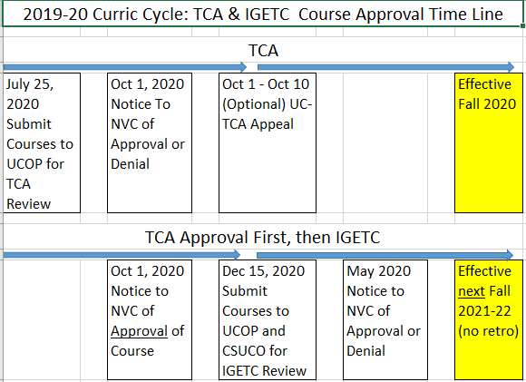
Sample Timeline for TCA & IGETC Approvals
Best Practice: For UC Transferability and Transfer GE proposals, consider aligning when new or modified course is first offered to the effective term of articulation approval.

Slide 6
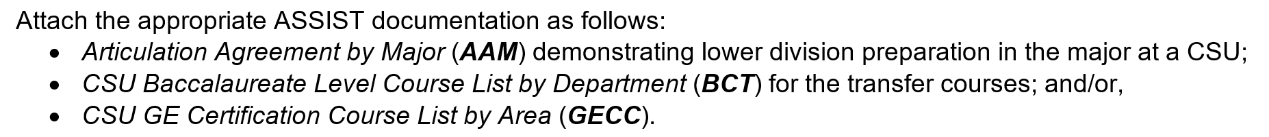
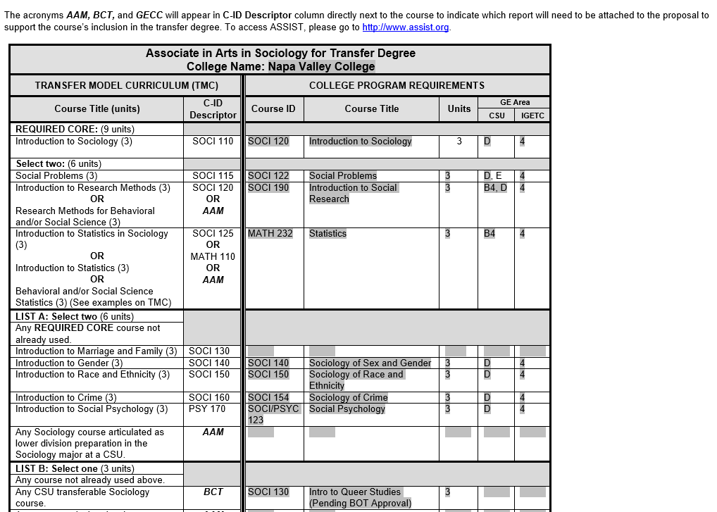
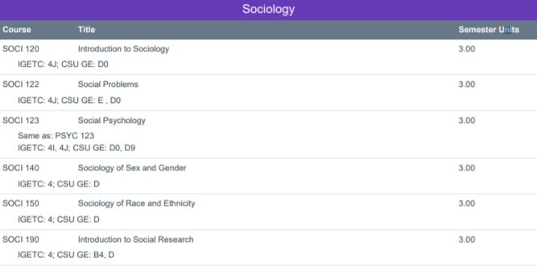
COCI Submission required for TMC: AAM, BCT & GECC
(The AO supports faculty by providing required information)
ASSIST.org documentation is required per CO in support of TMC submission

Slide 7
51% Articulation (for “transfer degrees”)
(The AO supports faculty by providing required information)
For PROGRAMS that declare “TRANSFER”
PCAH 6th “ASSIST documentation verifying that a majority (51% or greater) of the required courses in the program are articulated for the major (AAM) at the single baccalaureate institutions to which the program’s students are likely to transfer.”
AKA 51% documentation- what does it mean?
51% of the courses in YOUR PROGRAM, must be articulated at one CSU or UC.
Example: Your program has 8 courses- you must find 5 of those courses articulated at one CSU/UC as shown in ASSIST.

Slide 8

Best Practice: Consult with AO during preplanning!
Best Practices
Challenges
Questions

