Slide 1

NVC Foundation and Financial Aid/EOPS Office
2022/2023 Scholarship Application Workshops
MONDAY, DECEMBER 5, 2022 from 1:00 to 2:00
FRIDAY, JANUARY 20, 2023 from 11:00 TO 12:00
If you have questions during this workshop, please use the chat box
or use the Raise your Hand feature.

Slide 2
1. Who can apply for Napa Valley College (NVC) Foundation Scholarships?
Any current Napa Valley College student can apply.
Students should be enrolled in the Fall 2022 semester at Napa Valley College, and plan to re-enroll at Napa Valley College in Spring 2023.
Students continuing at Napa Valley College in Fall 2023 or transferring to a university in Fall 2023 are eligible for scholarships.

Slide 3
2. How do I apply for scholarships?
The entire application process takes place online using the AwardSpring scholarship program. Following is a brief summary of the application process:
Go to the Scholarships page at www.napavalley.edu and click the “Apply Now” link to AwardSpring. Follow the instructions to register as a user. Once registered, you can sign in and out as many times as you need to complete your application.

Slide 4
2. How do I apply for scholarships? (continued)
Provide all of the information requested on each section of the application. Your answers are very important and help AwardSpring match you to the right scholarships.
Read all answer options before choosing one (or more).
When you get to the Letter of Recommendation section, read the instructions carefully. As a reminder, students will need at least one letter of recommendation returned to complete the application. You may submit up to three requests.

Slide 5
3. How do I apply for specific scholarships?
The AwardSpring application wizard will match you to the scholarships for which you most likely are qualified, based on the information you provide in your application.

Slide 6
4. When is the application deadline?
February 7, 2023 at 11:59pm is the deadline for Spring 2023 awards.
Recommendation letters are due by Friday February 10, 2023 by 5:00pm. More information about recommendations will follow.

Slide 7
5. What tips or suggestions do you have for me as I complete the application form?
Review HELPFUL TIPS and FAQs that will be emailed to you after the workshop.
Fill in the application form completely and honestly. Once the application closes, we will be able to confirm such things as your completed credits, GPA, and financial aid status.
Use proper grammar and capitalization. Typos, blanks, and/or incomplete or inaccurate information may count against you in the review process.

Slide 8
5. What tips or suggestions to you have for me as I complete the application form. (continued)
For “Essay Responses”, be sure to completely answer all of the parts of each question. We recommend that you prepare your answers in WORD and save them ahead of time. Then copy and paste your answers into the application.
Make sure your current name and NVC ID#, and any other prior names that you have had, are on any documents that you upload/attach to your application!

Slide 9
6. If you applied for an NVC Foundation scholarship in a prior year…
You will need to request a new letter of recommendation. We require a current recommendation letter every year. One is required, up to three may be requested.
Review responses from last year that have auto-populated, and update as needed (address, phone, academic information, qualifications).

Slide 10
7. Who should complete a letter of recommendation for me?
A current Napa Valley College instructor, counselor or advisor should complete the letter of recommendation form.
Recommendations from family members, roommates, friends or neighbors are discouraged.

Slide 11
8. Can my references submit a recommendation directly to NVC instead of using the Recommendation Form provided through AwardSpring?
The Recommendation Form that is provided through AwardSpring is preferred.
One letter of recommendation is all that is required. Please do not request more than three.
If we do not receive a recommendation, your application will be considered incomplete.

Slide 12
9. When and how will recipients be notified?
Applicants will be notified of their awards by email during the first week in May 2023.
If your email or mailing address changes after the application closes, please send updates to mvillante@napavalley.edu

Slide 13
10. How and when will I receive my scholarship funds, if I receive an award?
NVC Foundation scholarship awards are disbursed according to donor specifications.
Most scholarships are presented at the awards ceremony, or mailed to students if a ceremony is not possible.
Others are issued upon verification of enrollment for the next academic year.

Slide 14
11. Will a scholarship affect my other sources of financial aid?
NVC Financial Aid Office is required to report all scholarship awards so that aid for a student is coordinated.
In general, scholarships do not affect a student’s grants, but they may reduce the amount of loans and/or work study that a student will receive.

Slide 15
Getting Started
Use Chrome, Safari, or Firefox as your browser.
This application does not support Internet Explorer.
Go to www.napavalley.awardspring.com
Create an account
Complete each section of the application
Compose essay responses
Select a recommender (up to three) to contact

Slide 16
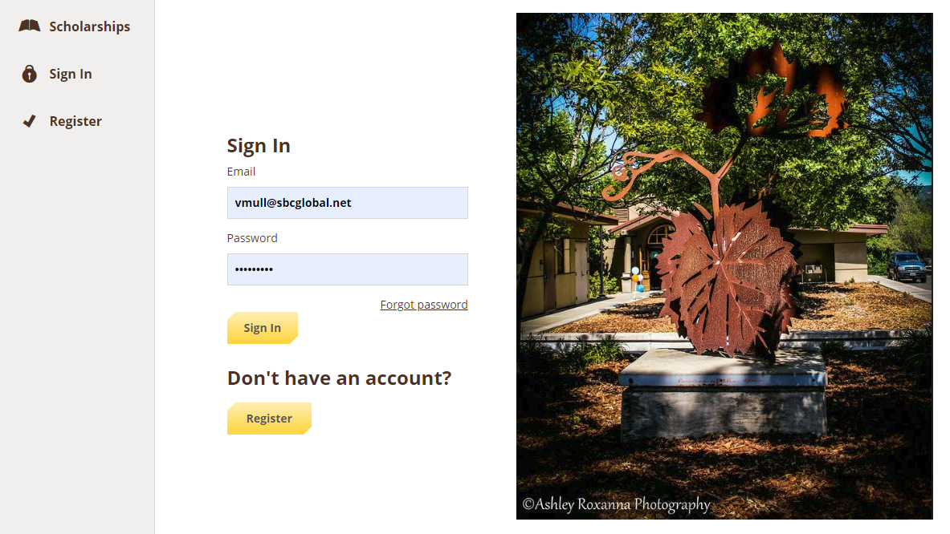
Create an account
Students with existing AwardSpring accounts may continue to use their current username/email to login. If you are creating a new account, we encourage you to use your NVC student email address.
https://napavalley.awardspring.com

Slide 17
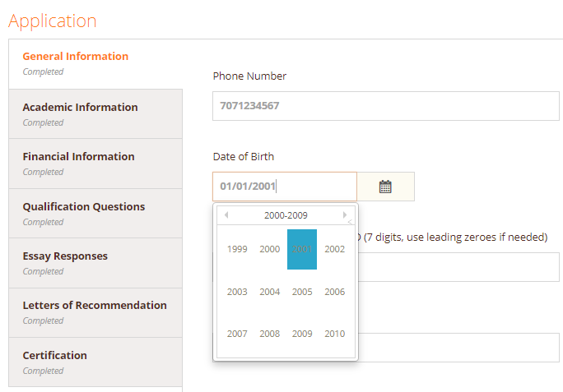
Begin completing the General Information section. Your phone number will automatically format. Use the calendar icon to select your birthdate, and also use the drop down box to select your state of residence. Complete all sections of the page.

Slide 18
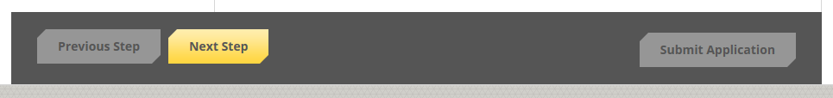
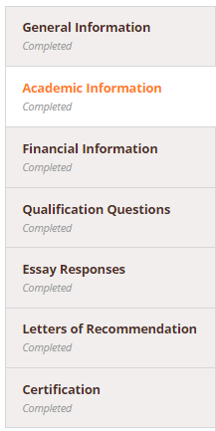
When you have completed each field on a page successfully, the status will update to Completed and the Next Step button will turn yellow. Click to continue.
Continue through each section. In order to advance through each section of the application you must enter something in a field.
As you progress through the application you will see that each section is marked Completed. You can log out at any time and return to work on your application.

Slide 19
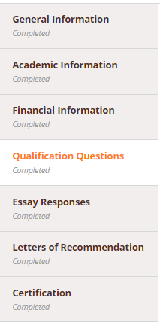
The Qualification Questions match you to specific scholarship criteria. Read and respond carefully in order to maximize your eligibility for scholarship awards!
When you have completed the Qualification Questions, click on the Next Step button to continue.

Slide 20
1. Tell us about your background and experiences. Clarify any extenuating circumstances related to your personal situation (i.e., overcoming adversity, more than one immediate family member in college, changes in your family's financial situation, etc.).
ESSAY QUESTIONS
Examples of extenuating circumstances:
More than one immediate family member in college
Changes in your family's financial situation caused by loss of job, illness or injury, income reduction
Change in family composition

Slide 21
2. Tell us about your short-term and long-term plans and how they relate to your proposed career/occupational goals. Please be as specific as you can, if you plan to pursue teaching as a career, please elaborate including grade level you plan to teach.
Example:
My short-term goal is to transfer to a four year university and pursue a degree in liberal studies, and my long term goal is to get a teaching credential so I can accomplish my dream of becoming an elementary school teacher.

Slide 22
3. Tell us how you serve your community. Describe your activities in community and/or volunteer services. Be specific, please include the names of the organizations.
Examples:
I volunteered a total of 30 hours at the Napa Animal Shelter where I walked the dogs and cleaned the kennels.
I tutored and organized after-school activities at the Boys and Girls Club for 80 hours over the school year.
I organized fund-raisers and served as room parent for my children’s school for a total of 40 hours last year.
I coached Napa Youth Soccer for 48 hours this Fall.
You may also explain why you have been unable to perform community service, and your past community service activities.

Slide 23
4. Tell us about your participation at NVC. Describe your participation in NVC clubs, activities, athletics, and student programs. You may also include any other honors, awards or personal achievements, and describe opportunities to demonstrate your leadership qualities.
Examples:
Holding an elected position in ASNVC or student club
Participating in campus activities like serving on NVC committees as a student representative, writing articles for the NVC newsletter, or athletics
Active participation in programs like EOPS, MESA, Puente, UMOJA, Student Support Services
Phi Theta Kappa - NVC Honor Society Member
Finalist in the NVC Jessamyn West Writing Contest
Selected to work as a Peer Tutor in the Writing Center
Represented NVC in statewide academic competitions

Slide 24
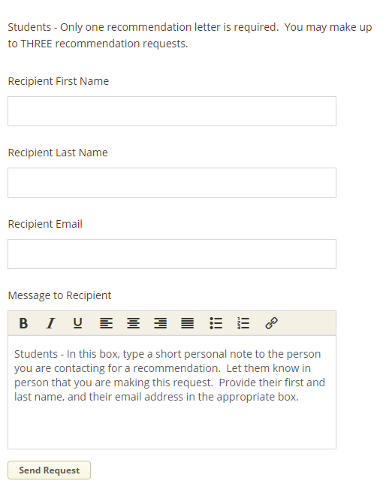
Request a
Recommendation
One recommendation is required, you can request up to three recommendations.
Personalize your request. Review contents of Message to Recipient box, delete the instructions, then compose a note to your recommender in this same box.

Slide 25
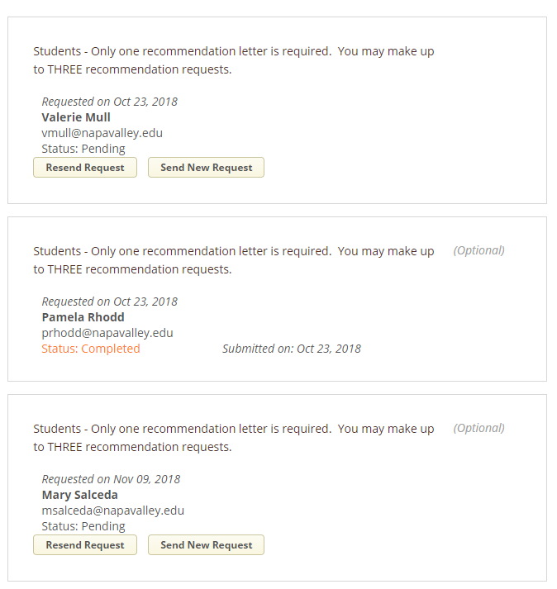
Confirm
Recommendation
When the request is fulfilled you will see Status: Completed. You may Resend a Request or Send a New Request to another person.
Once the application closes on February 7 you will not be able to return to this screen.
We will follow up on any missing recommendations.

Slide 26
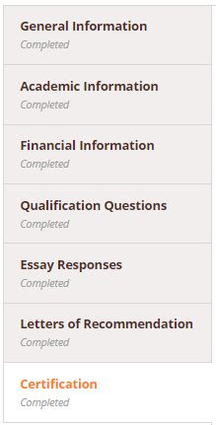

Certification
The Certification statement grants permission to the scholarship committee and reviewers to consider your application and academic information for the purposes of application review and administration and promotion of the scholarship program.
This is the final step in your scholarship application. The Submit button turns
yellow when all areas are completed.
To finish click

Slide 27
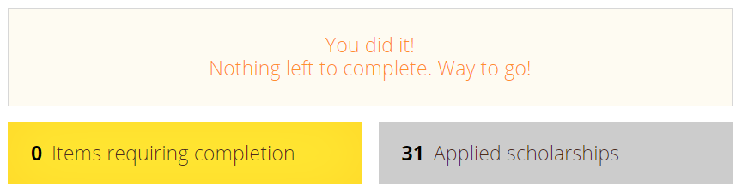
You will see a confirmation page and be able to view a list of scholarships you most likely are qualified for, and have automatically applied to.
You may still return to your application to make changes or updates, until the application period closes on
February 7, 2023 at 11:59 pm.

Slide 28

Award notifications will be emailed to students in early May.
For AwardSpring application assistance contact
Michele Villante at the
Financial Aid/EOPS Office (707) 256-7306 or email mvillante@napavalley.edu

Slide 29

Scholarships are made possible through the generosity of Napa Valley College Foundation donors and contributors.
For more information, please visit
https://www.napavalley.edu/about/napa-valley-college-foundation/index.html

